Slide 1
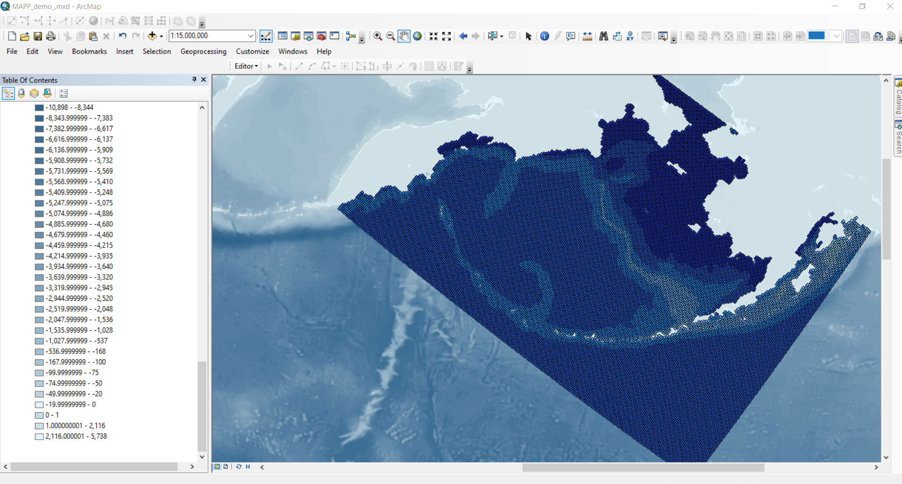
Viewing NETCDF files in ArcMap

Slide 2
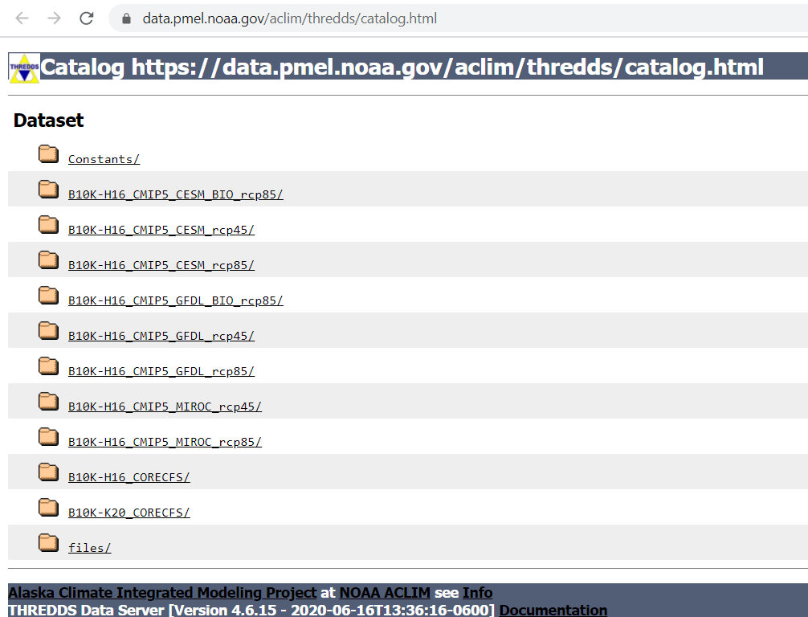
Viewing NETCDF files in ArcMap: downloading file
Download NETCDF files of interest
https://data.pmel.noaa.gov/aclim/thredds/catalog.html

Slide 3
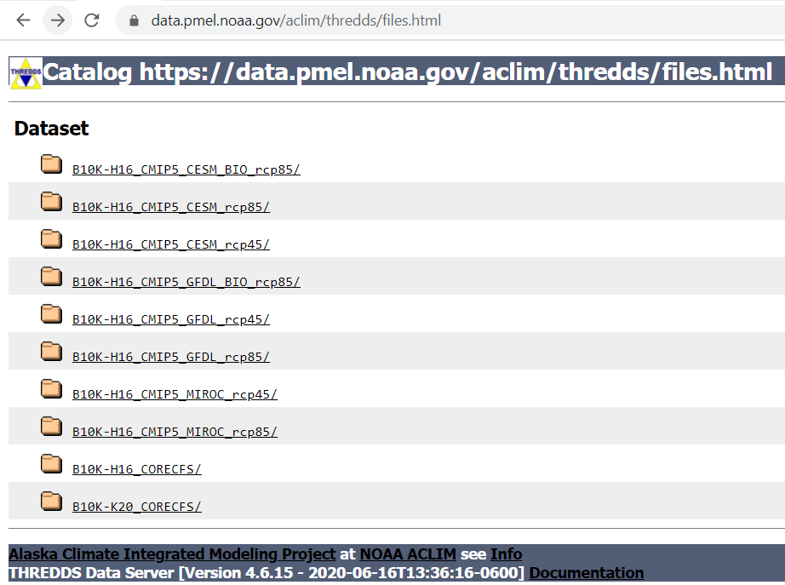
Viewing NETCDF files in ArcMap
Download NETCDF files of interest
https://data.pmel.noaa.gov/aclim/thredds/catalog.html
Files > Hindcast files:
B10K-H16_CORECFS/ (1st gen)
B10K-K20_CORECFS/ (2nd gen)

Slide 4
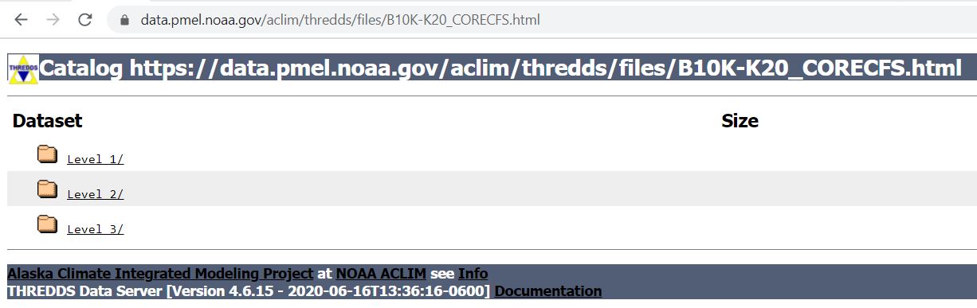
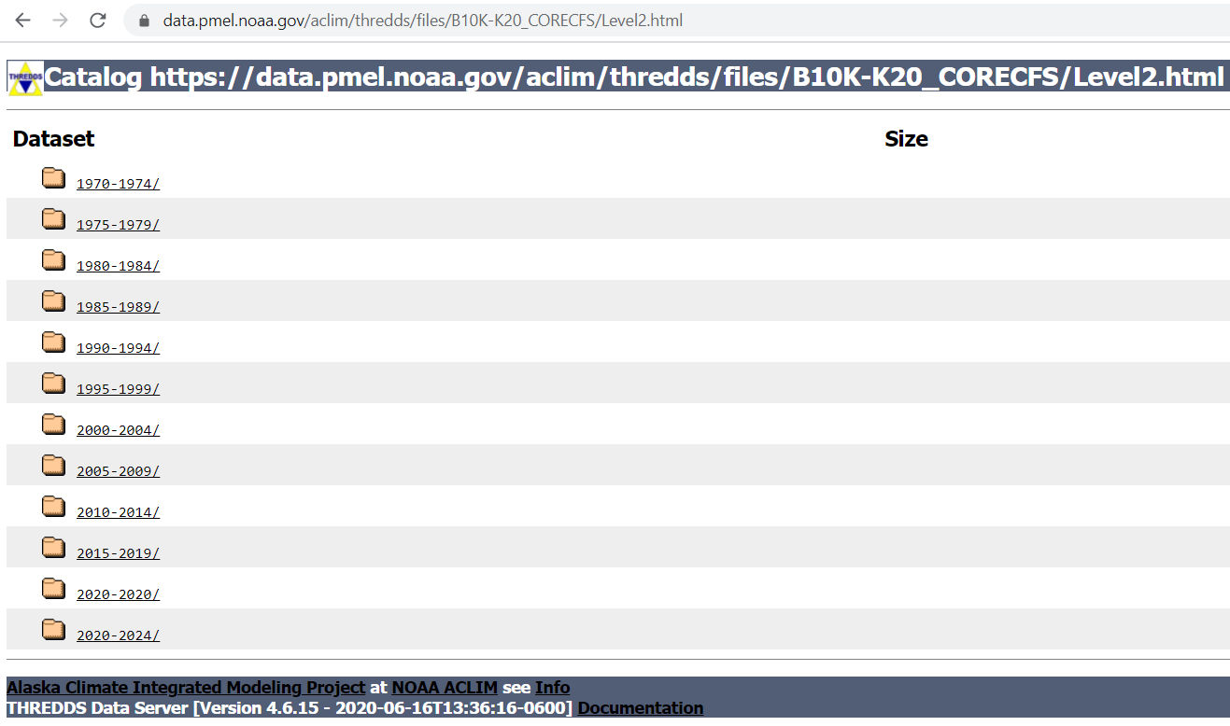
c
choose Level 2
choose 5 year period
Example is 2015-2019
c

Slide 5
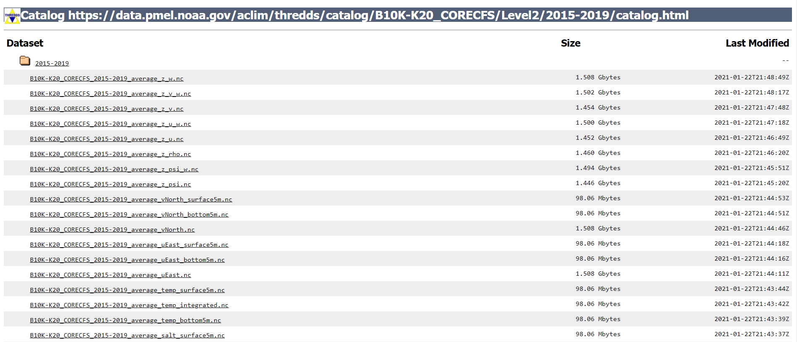
Choose file with variable of interest B10K-K20_2015-2019_average_temp_bottom5m.nc

Slide 6
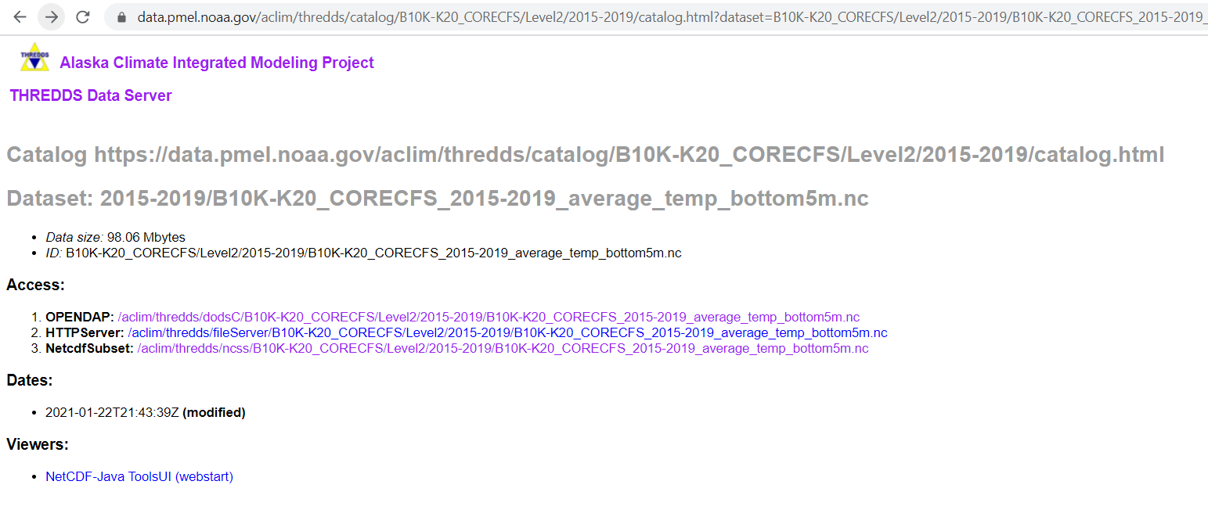
Choose HTTPServer

Slide 7
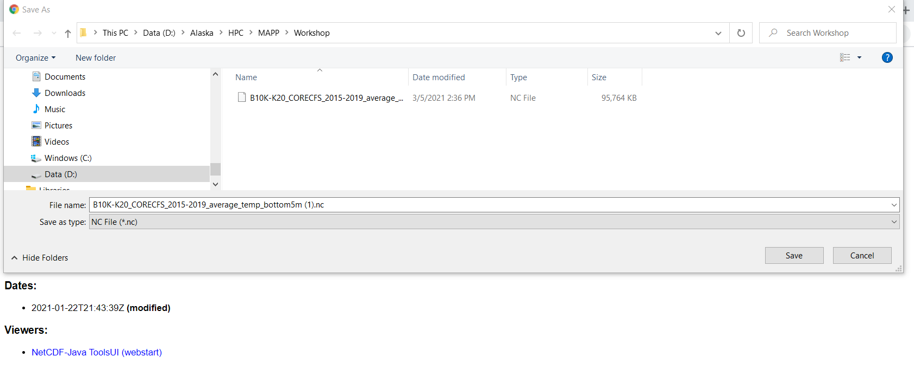
Save file in preferred location

Slide 8
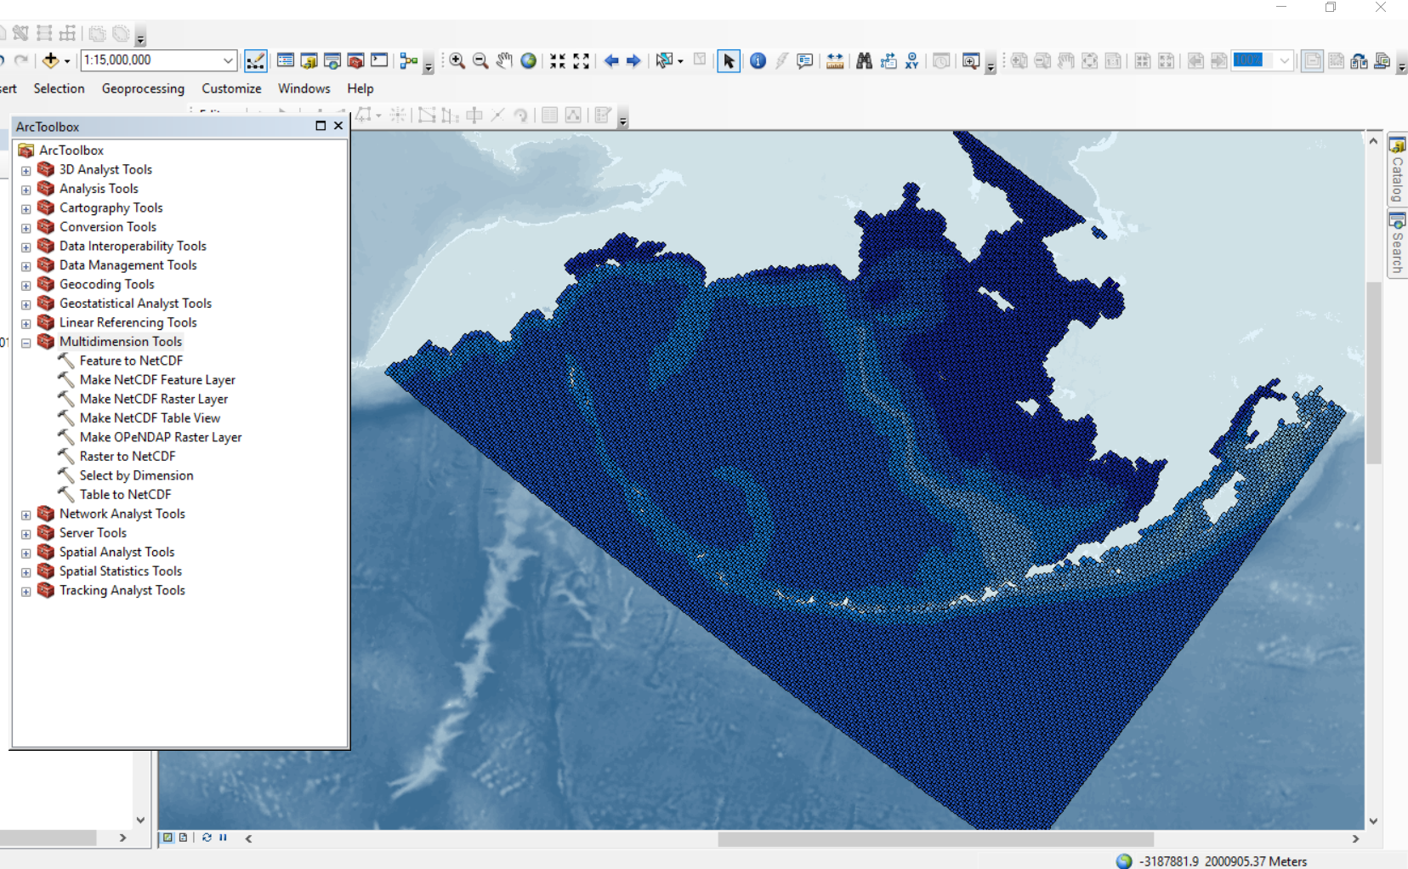
Arc Toolbox Icon
Arc Toolbox:
Multidimension
Tool

Slide 9
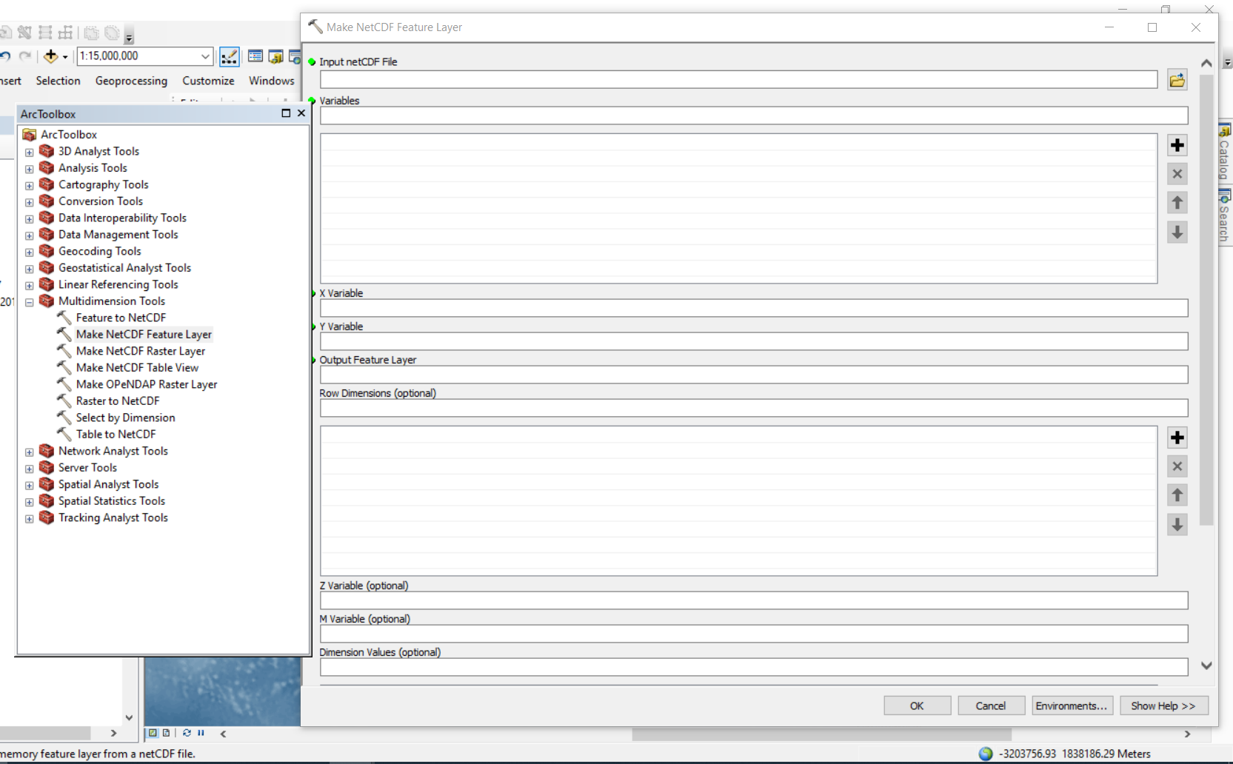
Arc Toolbox:
Multidimension
Tool
>Make NetCDF Feature Layer
(will open as point data)

Slide 10
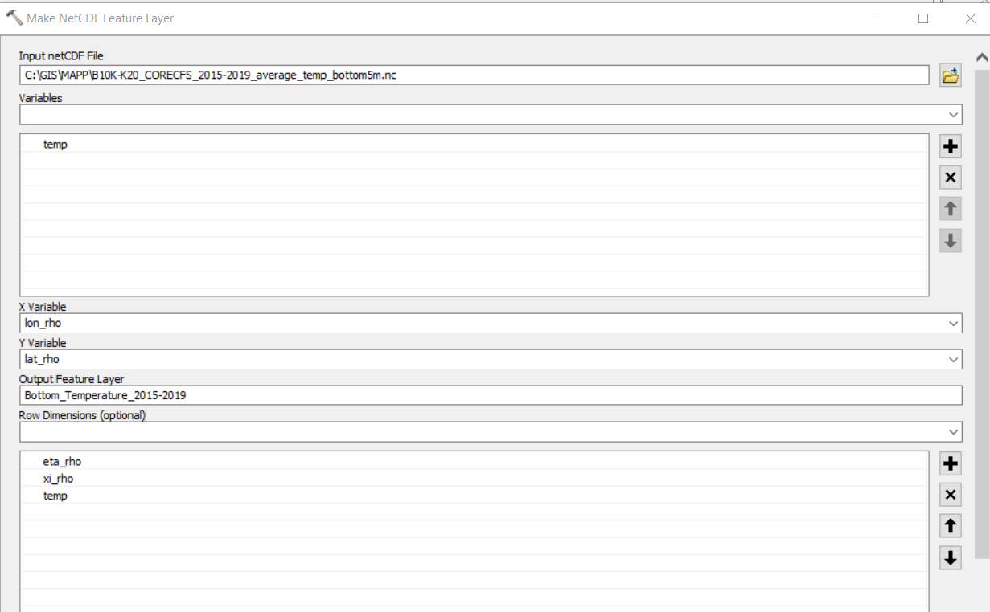
Input: File location
Variable: choose from drop down
(ignore lat_rho, long_rho, ocean_time and zeta)
X and Y variable will self-populate
Enter output Feature layer name
Row dimensions choose eta_rho and xi_rho from drop down menu, enter temp manually

Slide 11
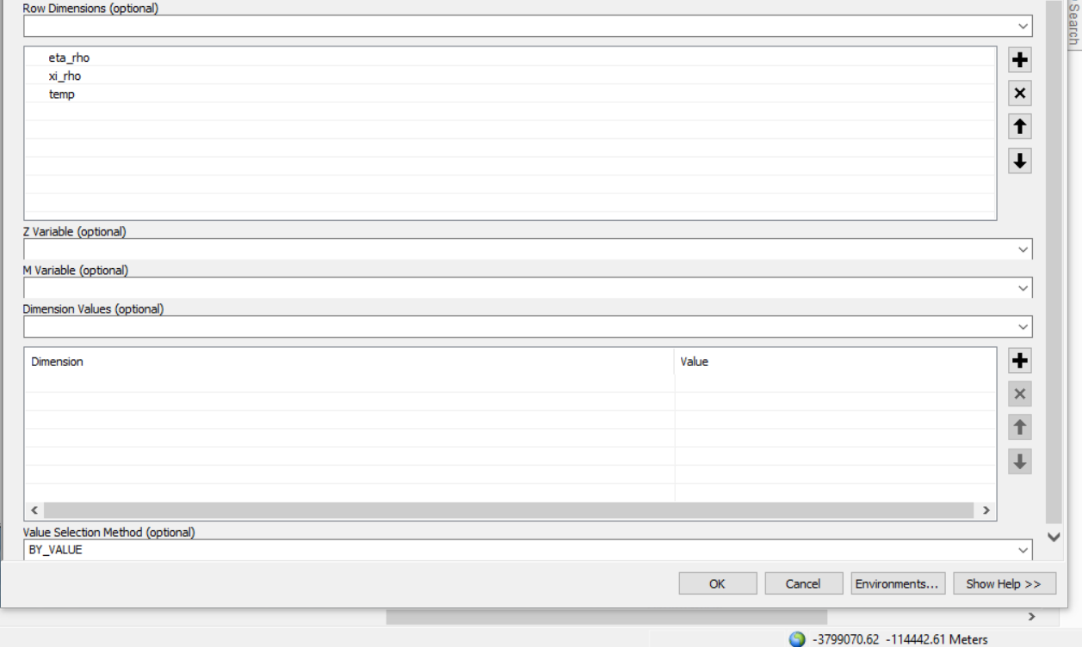
Dimension Values choose ocean_time from drop down menu
Value selection method BY VALUE
Click OK

Slide 12
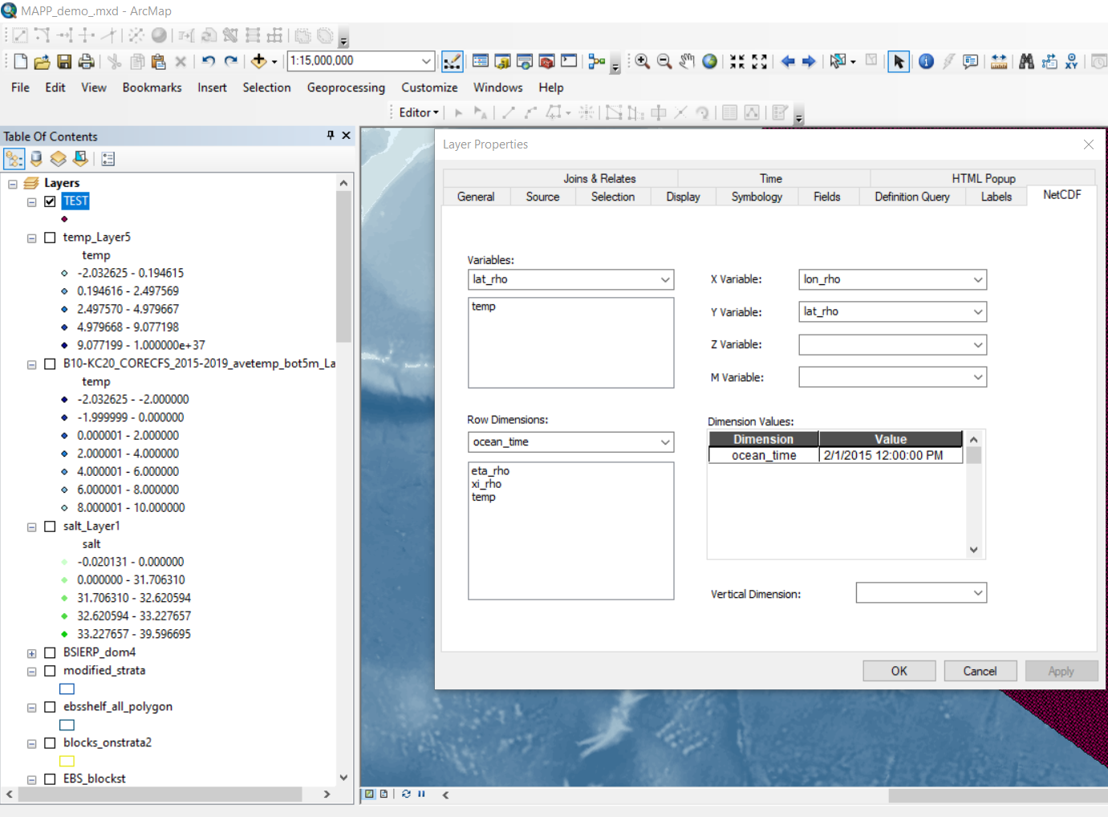
Layer will appear on menu but no layer will be displayed
Open the Layer properties and go to NETCDF tab
In Dimension Values, select a date from the drop down menu
Click OK

Slide 13
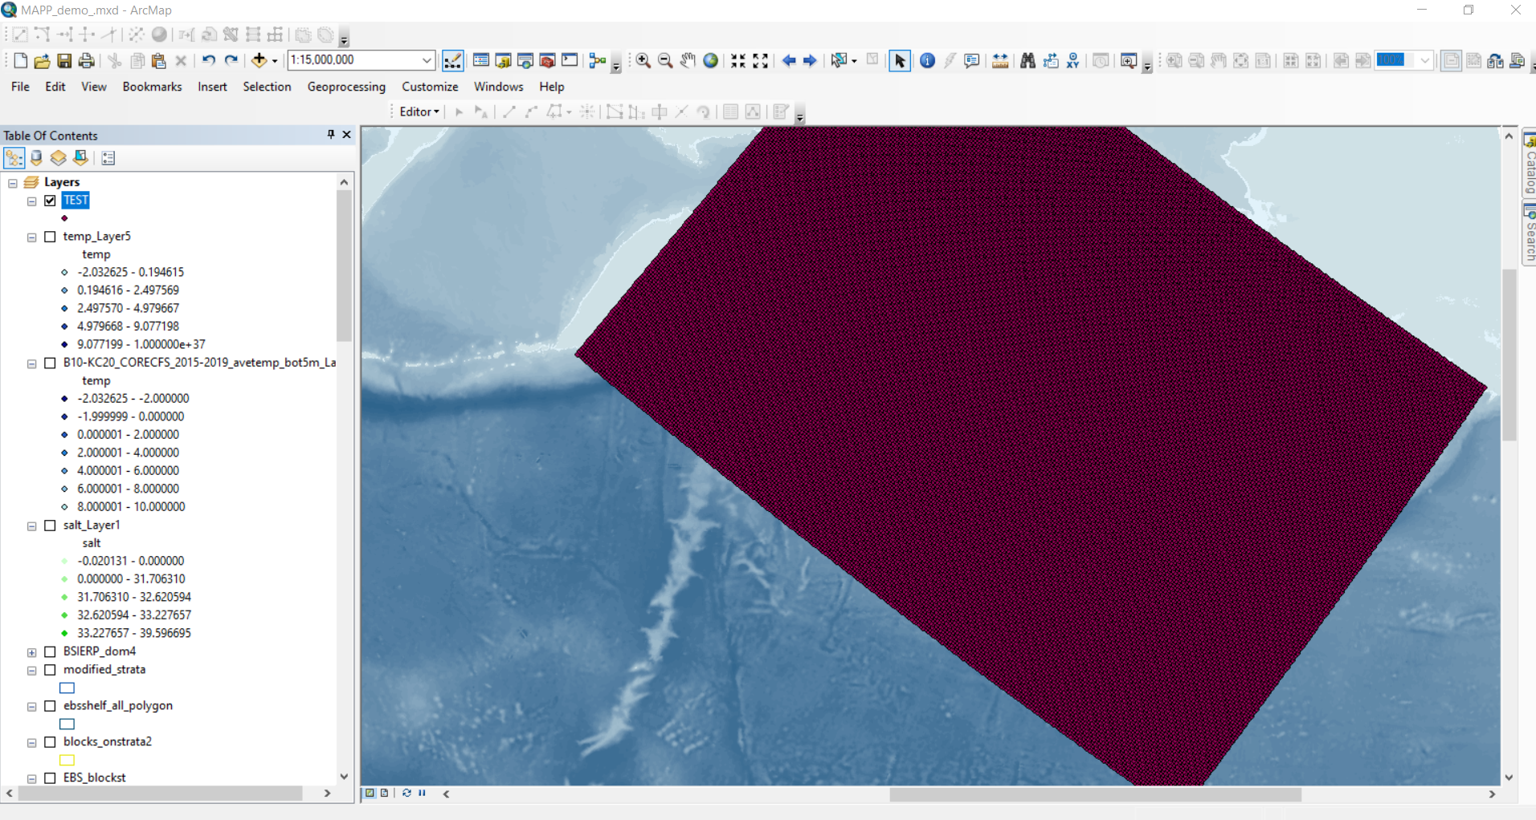
Layer will now display
Go to Layer properties again to choose symbology

Slide 14
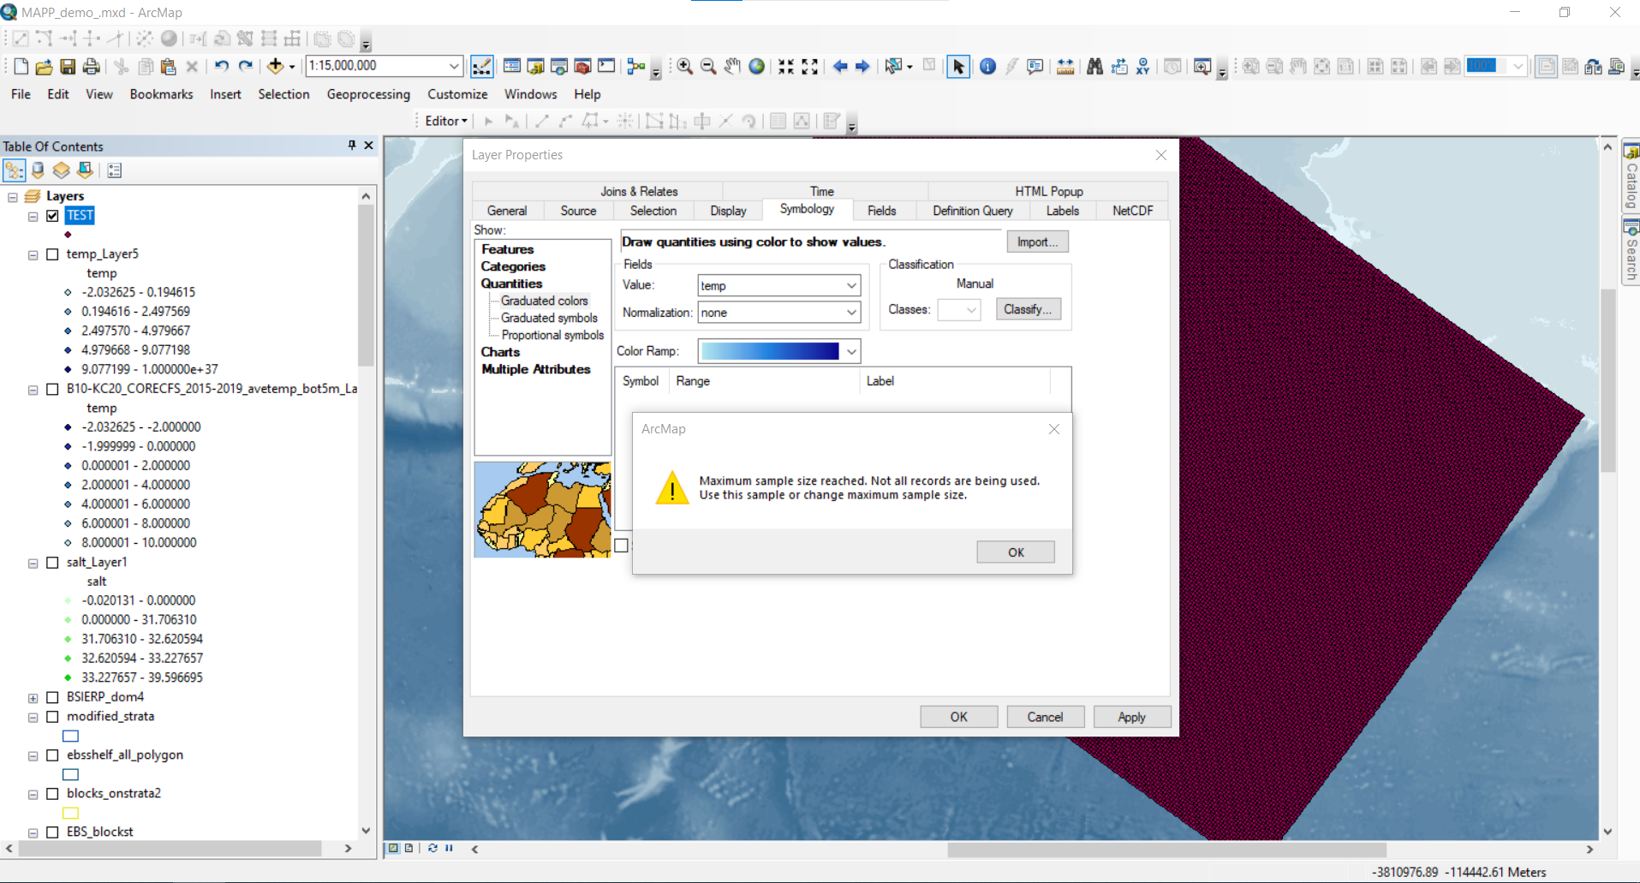
Layer will now display
Go to Layer properties again to choose symbology
Quantities> Graduated colors
Choose value temp
Choose color ramp
Increase sampling size if necessary by clicking on Classify

Slide 15
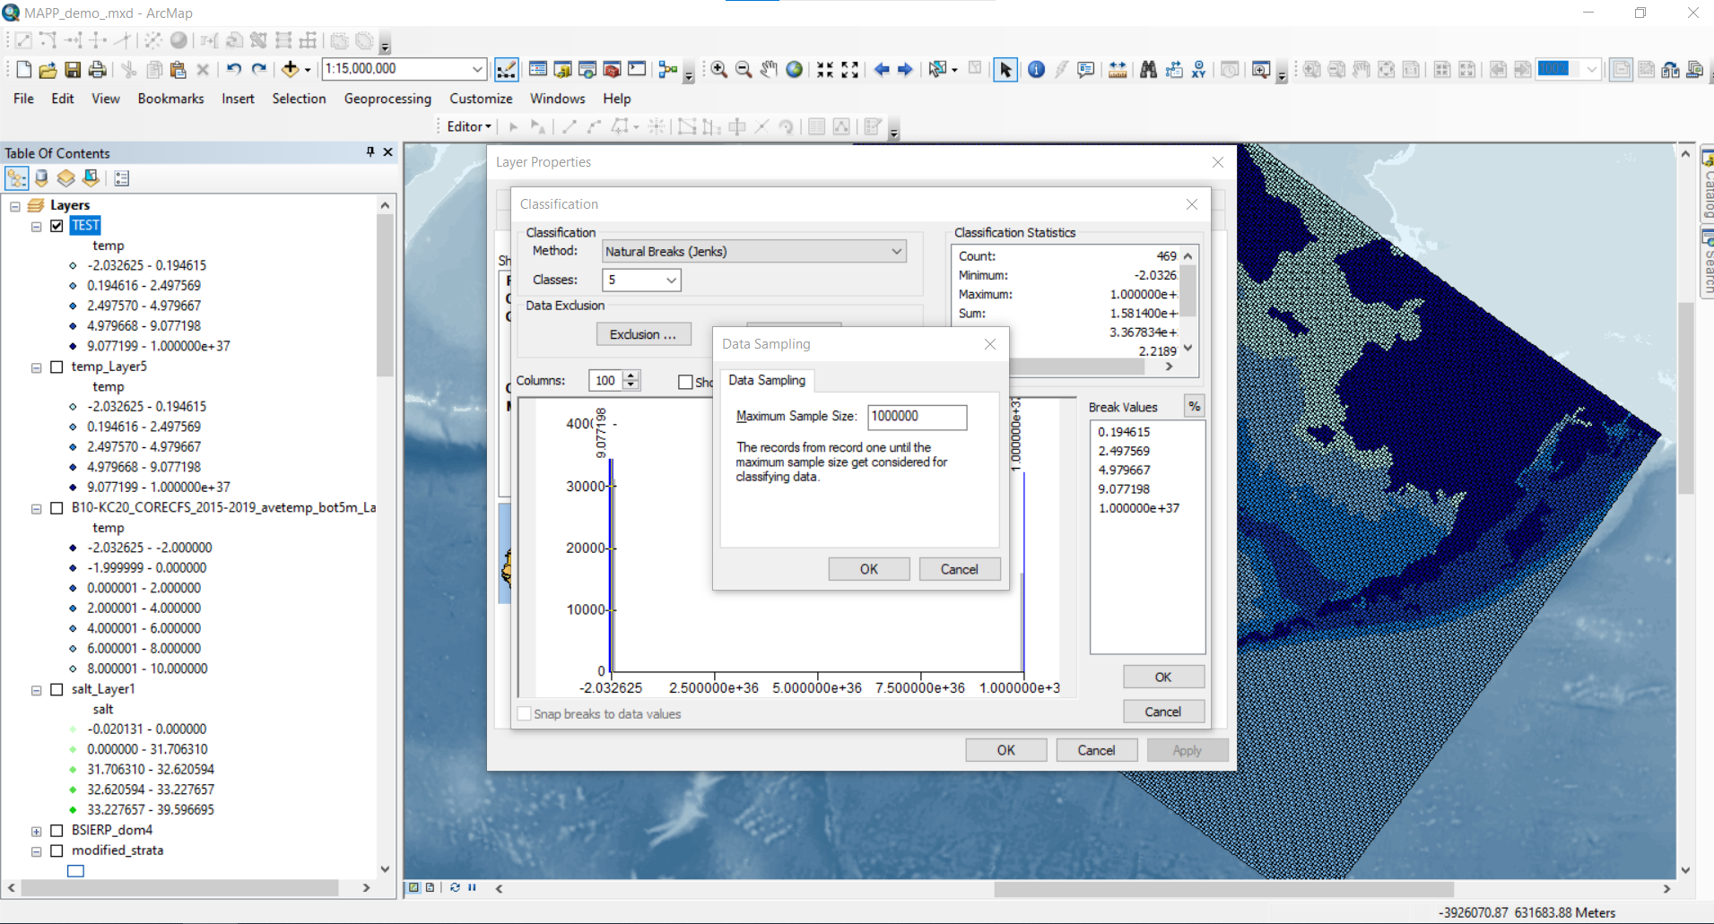
Increase sampling size if necessary
Click on Sampling and increase minimum sampling size
Click OK on all menus to display layer

Slide 16
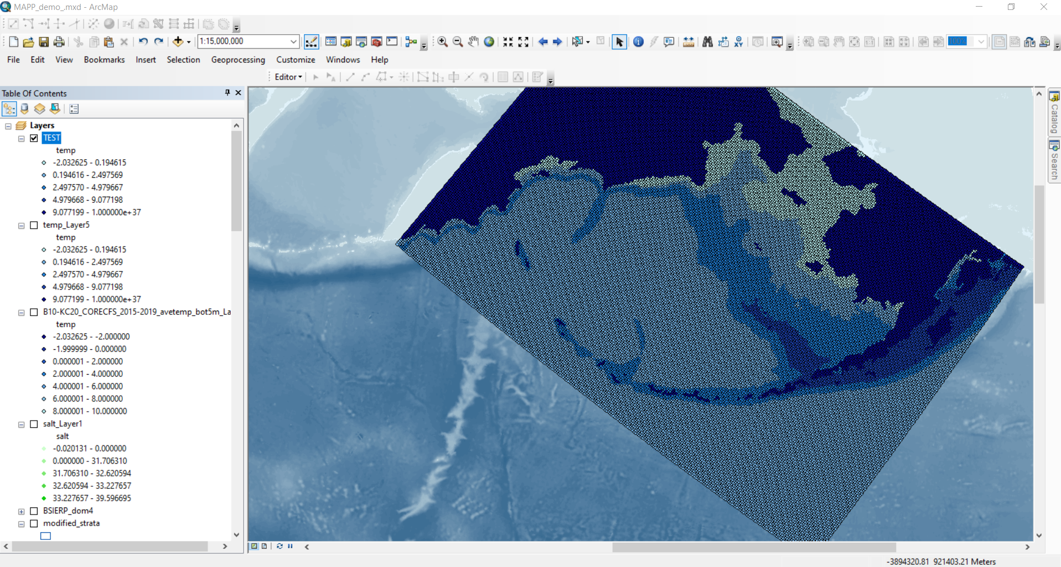

Slide 17
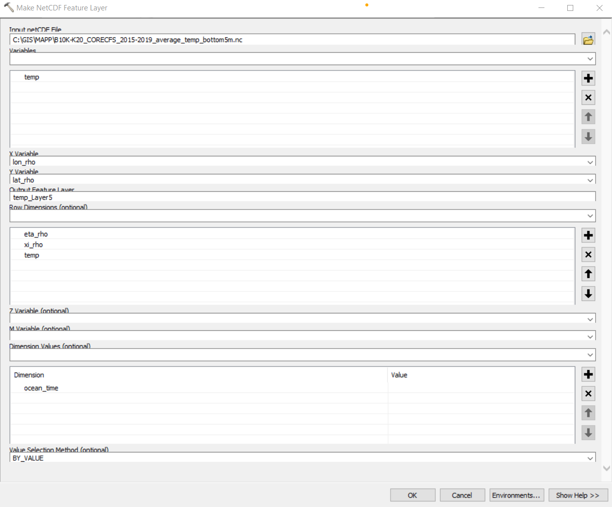
Recap: input
Arc Toolbox
Multidimension Tools
Make NETCDF Feature Layer
Choose variable temp
In Row Dimesion temp should be entered manually

